Slide 1
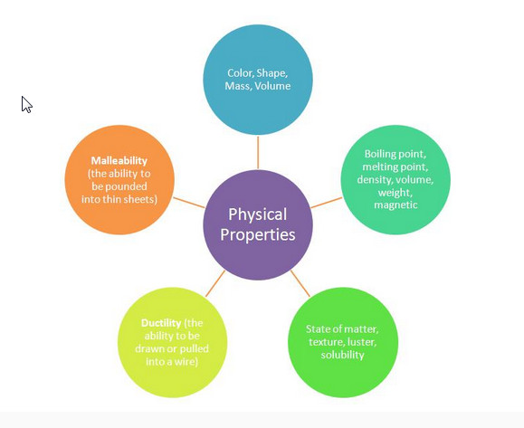
Physical Boot Camp
5.5A Part 1
Classify matter based on physical properties including: mass, magnetism, physical state (solid, liquid and gas), relative density (sinking and floating), solubility in water, and the ability to conduct or insulate thermal energy or electric energy.

Slide 2
STAAR 2013 #2; RC 1; Readiness 36. Which of these is the best conductor of electricity? F. Glass rod G. Cotton string H. Plastic tubing J. Copper penny

Slide 3
STAAR 2013 #2; RC 1; Readiness 36. Which of these is the best conductor of electricity? F. Glass rod G. Cotton string H. Plastic tubing J. Copper penny

Slide 4
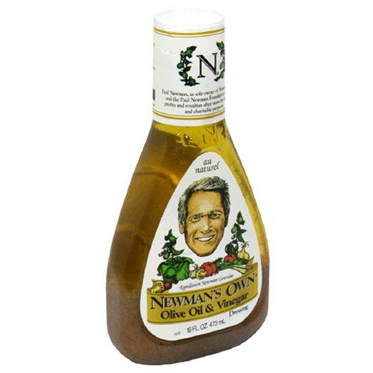
37. A student reads the label on a bottle of salad dressing down below. Why would the student shake the salad dressing well before using it? A. Vinegar and oil have different densities. B. Vinegar and oil easily form a solution. C. Vinegar and oil both contain water. D. Vinegar and oil are both liquids
Ingredients:
Oil, Vinegar, Spices
Directions: Shake well before using. Refrigerate after opening.

Slide 5
37. A student reads the label on a bottle of salad dressing down below. Why would the student shake the salad dressing well before using it? A. Vinegar and oil have different densities. B. Vinegar and oil easily form a solution. C. Vinegar and oil both contain water. D. Vinegar and oil are both liquids
Ingredients:
Oil, Vinegar, Spices
Directions: Shake well before using. Refrigerate after opening.

Slide 6
38.

Slide 7
38.

Slide 8
39. Which of the following can be attracted to a magnet?
F Gold ring
G Glass marble
H Iron needle
J Wool sock

Slide 9
39. Which of the following can be attracted to a magnet?
F Gold ring
G Glass marble
H Iron needle
J Wool sock

Slide 10
40. Matter can undergo changes. When water boils, a —
F liquid becomes a solid
G solid becomes a liquid
H liquid becomes a gas
J gas becomes a solid

Slide 11
40. Matter can undergo changes. When water boils, a —
F liquid becomes a solid
G solid becomes a liquid
H liquid becomes a gas
J gas becomes a solid

Slide 12
41. Some types of matter can conduct electrical energy. What other type of energy can be conducted by some types of matter?
A Kinetic energy
B Heat energy
C Potential energy
D Gas energy

Slide 13
41. Some types of matter can conduct electrical energy. What other type of energy can be conducted by some types of matter?
A Kinetic energy
B Heat energy
C Potential energy
D Gas energy

Slide 14
42. Which of the following is a form of water in its gaseous state?
A Sleet
B Rain
C Vapor
D Clouds

Slide 15
42. Which of the following is a form of water in its gaseous state?
A Sleet
B Rain
C Vapor
D Clouds

Slide 16
43. Which of the following is the best definition of matter?
A Anything that you can see and has color
B Anything that you can smell or feel
C Anything found on the earth
D Anything that takes up space and has mass

Slide 17
43. Which of the following is the best definition of matter?
A Anything that you can see and has color
B Anything that you can smell or feel
C Anything found on the earth
D Anything that takes up space and has mass

Slide 18
44. Matter has a fixed volume, but changes its shape to fit its container, it is a .
A Solid
B Liquid
C Gas
D Plasma

Slide 19
44. Matter has a fixed volume, but changes its shape to fit its container, it is a .
A Solid
B Liquid
C Gas
D Plasma

Slide 20
45. What process occurs when decreased heat causes a gas to change into a liquid?
A Condensation
B Evaporation
C Boiling
D Melting

Slide 21
45. What process occurs when decreased heat causes a gas to change into a liquid?
A Condensation
B Evaporation
C Boiling
D Melting

Slide 22
46. What process occurs when a liquid changes to a gas?
A Condensation
B Freezing
C Evaporation
D Melting

Slide 23
46. What process occurs when a liquid changes to a gas?
A Condensation
B Freezing
C Evaporation
D Melting

Slide 24
47. A student broke a piece off of a rock. What property of the rock changed?
A The rock’s mass
B The rock’s color
C The rock’s roughness
D The rock’s smell

Slide 25
47. A student broke a piece off of a rock. What property of the rock changed?
A The rock’s mass
B The rock’s color
C The rock’s roughness
D The rock’s smell

Slide 26
48. Which of the following objects would be the best conductor of heat?
A A metal spoon
B A plastic jar
C A wooden pencil
D A paper box

Slide 27
48. Which of the following objects would be the best conductor of heat?
A A metal spoon
B A plastic jar
C A wooden pencil
D A paper box

Slide 28
49. Some students were given a plastic bag containing the following objects: a penny, a marble, a stick of gum, a Popsicle stick, a marshmallow, and a piece of string. Which of the following is NOT a valid property for separating the items into two groups?
A Type of material
B Mass of object
C Age of material
D Ability to conduct electricity

Slide 29
49. Some students were given a plastic bag containing the following objects: a penny, a marble, a stick of gum, a Popsicle stick, a marshmallow, and a piece of string. Which of the following is NOT a valid property for separating the items into two groups?
A Type of material
B Mass of object
C Age of material
D Ability to conduct electricity

Slide 30
50. Matter is often classified based on its physical properties. Which list of physical properties correctly identifies a penny?
A Liquid, conducts heat well, does not conduct electricity, is magnetic
B Solid, conducts heat and electricity well, is not magnetic, is a type of metal
C Liquid, is a type of metal, conducts heat and electricity well, is magnetic
D Solid, conducts heat well, does not conduct electricity, is not magnetic

Slide 31
50. Matter is often classified based on its physical properties. Which list of physical properties correctly identifies a penny?
A Liquid, conducts heat well, does not conduct electricity, is magnetic
B Solid, conducts heat and electricity well, is not magnetic, is a type of metal
C Liquid, is a type of metal, conducts heat and electricity well, is magnetic
D Solid, conducts heat well, does not conduct electricity, is not magnetic

Slide 32
51. The following are all characteristics of a liquid EXCEPT—
A a liquid has a definite volume
B a liquid takes the shape of its container
C a liquid has a definite shape
D a liquid can usually be poured

Slide 33
51. The following are all characteristics of a liquid EXCEPT—
A a liquid has a definite volume
B a liquid takes the shape of its container
C a liquid has a definite shape
D a liquid can usually be poured

Slide 34
52. What happens to the particles in a liquid when it is heated? The particles—
A move slower
B stop moving
C move faster
D move in a circle

Slide 35
52. What happens to the particles in a liquid when it is heated? The particles—
A move slower
B stop moving
C move faster
D move in a circle

Slide 36
53. A question on the fifth grade homework assignment asked students to explain why air is matter. Which of the following statements correctly answers the question?
A Air is invisible.
B Air is needed for breathing.
C Air takes up space and has mass.
D Air takes the shape of its container.

Slide 37
53. A question on the fifth grade homework assignment asked students to explain why air is matter. Which of the following statements correctly answers the question?
A Air is invisible.
B Air is needed for breathing.
C Air takes up space and has mass.
D Air takes the shape of its container.

