Slide 1
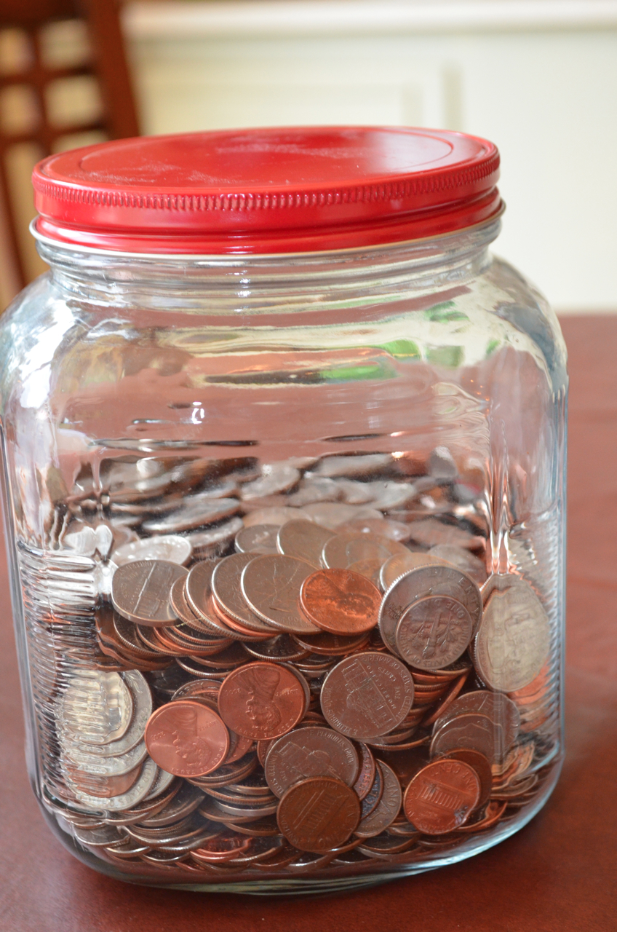
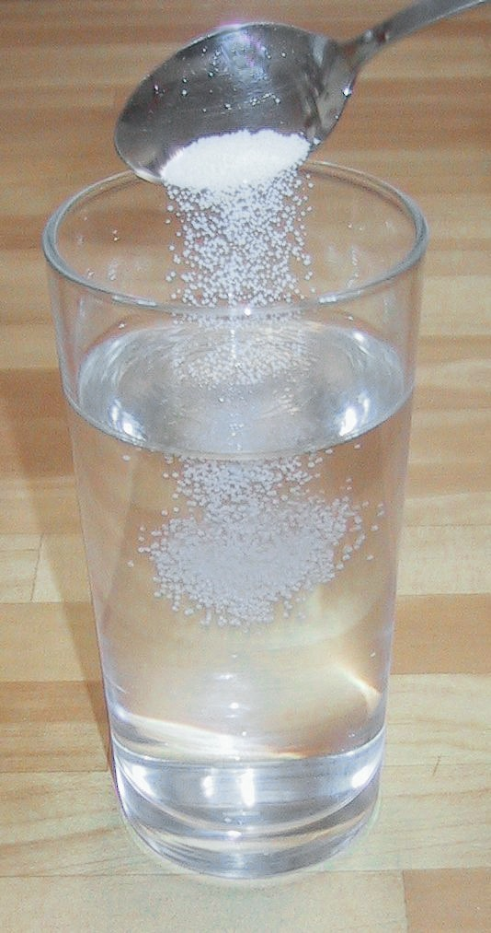
Physical Boot Camp
5.5D
Identify changes that can occur in the physical properties of the ingredients of solutions such as dissolving salt in water or adding lemon juice to water.

Slide 2
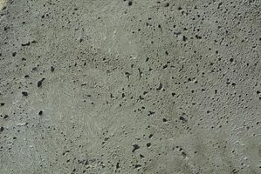
STAAR 2013 #40; RC1; Supporting 1. A worker built a sidewalk and pressed some large salt particles into the concrete while it was still wet. When the concrete was dry, the worker washed the sidewalk with the water. The picture below shows the sidewalk after it was washed: What most likely happened to the salt? F. It evaporated into a gas G. It turned into concrete H. It dissolved in the water J. It turned into a solid

Slide 3
STAAR 2013 #40; RC1; Supporting 1. A worker built a sidewalk and pressed some large salt particles into the concrete while it was still wet. When the concrete was dry, the worker washed the sidewalk with the water. The picture below shoes the sidewalk after it was washed: What most likely happened to the salt? F. It evaporated into a gas G. It turned into concrete H. It dissolved in the water J. It turned into a solid

Slide 4
2004 TAKS Information Booklet, #10
2. A student places a sugar cube in a beaker of water. What change will occur?
A The sugar cube will not change.
B More water will be formed.
C The sugar cube will become smaller.
D The water will form crystals.

Slide 5
2004 TAKS Information Booklet, #10
2. A student places a sugar cube in a beaker of water. What change will occur?
A The sugar cube will not change.
B More water will be formed.
C The sugar cube will become smaller.
D The water will form crystals.

Slide 6
TAKS Study Guide, #34
3. River water is a solution because it —
A is a liquid, which has no definite shape
B contains dissolved minerals and salts
C carries sand, clay, and other sediment
D is a compound made up of two elements

Slide 7
TAKS Study Guide, #34
3. River water is a solution because it —
A is a liquid, which has no definite shape
B contains dissolved minerals and salts
C carries sand, clay, and other sediment
D is a compound made up of two elements

Slide 8
5.

Slide 9
5.

Slide 10
5.

Slide 11
5.

Slide 12
2006—#27 (86%)
6. A teaspoon of clean, dry sand is added to a cup of warm saltwater. What is most likely to happen after the mixture is stirred and then placed on a table for five minutes?
A The amount of water will increase.
B The salt will float to the top.
C The sand will settle to the bottom.
D The cup will heat up.

Slide 13
2006—#27 (86%)
6. A teaspoon of clean, dry sand is added to a cup of warm saltwater. What is most likely to happen after the mixture is stirred and then placed on a table for five minutes?
A The amount of water will increase.
B The salt will float to the top.
C The sand will settle to the bottom.
D The cup will heat up.

Slide 14
8.

Slide 15
8.

Slide 16
9. If purple drink mix is added to water, what change will occur to the water?
A The drink mix will cause the water to freeze.
B The water will totally disappear.
C The drink mix will heat the water.
D The water will change color.

Slide 17
9. If purple drink mix is added to water, what change will occur to the water?
A The drink mix will cause the water to freeze.
B The water will totally disappear.
C The drink mix will heat the water.
D The water will change color.

Slide 18
10.

Slide 19
10.

Slide 20
11. A tablespoon of sugar is poured into a beaker of warm water and stirred briefly. What change will occur?
A The sugar will soak up the water.
B The water will change colors.
C The sugar will sink to the bottom.
D The sugar will dissolve in the water.

Slide 21
11. A tablespoon of sugar is poured into a beaker of warm water and stirred briefly. What change will occur?
A The sugar will soak up the water.
B The water will change colors.
C The sugar will sink to the bottom.
D The sugar will dissolve in the water.

Slide 22
12. Which of the following is the best example of the process of dissolving?
A Mixing chocolate powder in a glass of milk
B Pouring sand into a beaker of warm water
C Shaking a bottle of Italian salad dressing
D Pouring milk into a cup of hot coffee

Slide 23
12. Which of the following is the best example of the process of dissolving?
A Mixing chocolate powder in a glass of milk
B Pouring sand into a beaker of warm water
C Shaking a bottle of Italian salad dressing
D Pouring milk into a cup of hot coffee

Slide 24
13. What happens to sugar particles as they dissolve in water?
A The hot water changes the sugar into a new kind of water.
B The sugar particles melt very quickly in the hot water.
C The sugar particles spread out and fill in spaces in the water.
D The sugar particles are changed into a different kind of matter.

Slide 25
13. What happens to sugar particles as they dissolve in water?
A The hot water changes the sugar into a new kind of water.
B The sugar particles melt very quickly in the hot water.
C The sugar particles spread out and fill in spaces in the water.
D The sugar particles are changed into a different kind of matter.

Slide 26
14. Which mixture below is also a solution?
A Water and hot chocolate mix
B Soil and rocks
C Trail mix
D Tossed salad (no dressing)

Slide 27
14. Which mixture below is also a solution?
A Water and hot chocolate mix
B Soil and rocks
C Trail mix
D Tossed salad (no dressing)

Slide 28
15.

Slide 29
15.

Slide 30
16. A suspension is a special kind of mixture. In a suspension, particles of a solid are suspended in a liquid and will not dissolve. The particles are large enough to be seen and the suspension appears cloudy. If the particles settle to the bottom, shaking and stirring will suspend the particles again. Which of the following is a suspension?
A Kool-Aid® mixed with water
B Spices in vinegar and oil (salad dressing)
C Chocolate powder stirred into a glass of milk
D Milk stirred into a cup of hot coffee

Slide 31
16. A suspension is a special kind of mixture. In a suspension, particles of a solid are suspended in a liquid and will not dissolve. The particles are large enough to be seen and the suspension appears cloudy. If the particles settle to the bottom, shaking and stirring will suspend the particles again. Which of the following is a suspension?
A Kool-Aid® mixed with water
B Spices in vinegar and oil (salad dressing)
C Chocolate powder stirred into a glass of milk
D Milk stirred into a cup of hot coffee

Slide 32
17. When the ingredients for a chocolate cake are being mixed, the cake batter is like a thick, brown soup. Which physical property of the cake is the SAME after the batter is baked?
A Color
B Size
C Shape
D Texture

Slide 33
17. When the ingredients for a chocolate cake are being mixed, the cake batter is like a thick, brown soup. Which physical property of the cake is the SAME after the batter is baked?
A Color
B Size
C Shape
D Texture

Slide 34
18.

Slide 35
18.

Slide 36
19. Which property of a solution below is the same as the properties of its ingredients?
A Sugar water tastes sweet.
B Saltwater tastes salty.
C Sugar water is a liquid.
D Air is a gas.

Slide 37
19. Which property of a solution below is the same as the properties of its ingredients?
A Sugar water tastes sweet.
B Saltwater tastes salty.
C Sugar water is a liquid.
D Air is a gas.

Slide 38
20. Which property of a sugar cube does not change when it dissolves?
A Color
B Taste
C Shape
D Texture

Slide 39
20. Which property of a sugar cube does not change when it dissolves?
A Color
B Taste
C Shape
D Texture

Slide 40
21.

Slide 41
21.

Slide 42
22.

Slide 43
22.

Slide 44
23.

Slide 45
23.

Slide 46
24. A student mixed together 100 mL of warm water, 10 mL of salt, and 10 mL of paper clips in a large beaker. He left the beaker sitting on the table for next to a window for 2 weeks. What was left in the beaker after the two weeks?
A Only the salt
B Some water and the salt
C The salt and the paper clips
D Some water and the paper clips

Slide 47
24. A student mixed together 100 mL of warm water, 10 mL of salt, and 10 mL of paper clips in a large beaker. He left the beaker sitting on the table for next to a window for 2 weeks. What was left in the beaker after the two weeks?
A Only the salt
B Some water and the salt
C The salt and the paper clips
D Some water and the paper clips

Slide 48
25. When 5 grams of salt is added to 100 mL of water, which of the following changes will occur?
A The salt will float.
B The water will crystallize.
C The salt will dissolve.
D The water will freeze.

Slide 49
25. When 5 grams of salt is added to 100 mL of water, which of the following changes will occur?
A The salt will float.
B The water will crystallize.
C The salt will dissolve.
D The water will freeze.

Slide 50
26. Which statement about solutions is correct? A. All solutions contain more than two substances. B. A solution can only be created from liquids. C. All mixtures are solutions. D. All solutions are mixtures.

Slide 51
26. Which statement about solutions is correct? A. All solutions contain more than two substances. (2 or more) B. A solution can only be created from liquids. C. All mixtures are solutions. D. All solutions are mixtures.

Slide 52
27. Salt crystals + water = solution. What happened to the salt and water? A. They combined physically to form a special mixture. B. The salt and water evaporated. C. The salt and water separated, forming layers. D. The salt melted the water.

Slide 53
27. Salt crystals + water = solution. What happened to the salt and water? A. They combined physically to form a special mixture. B. The salt and water evaporated. C. The salt and water separated, forming layers. D. The salt melted the water.

Slide 54
28. A student dissolves 20 grams of salt in a pan of 200 milliliters of water. The student places the pan over a hot stove. How much salt is left after all the water evaporates? A. There is no salt left because it evaporated with the water. B. 20 grams of salt is left after all the water evaporates. C. 10 grams of salt evaporates, leaving 10 grams in the pan. D. Neither the salt nor the water evaporates.

Slide 55
28. A student dissolves 20 grams of salt in a pan of 200 milliliters of water. The student places the pan over a hot stove. How much salt is left after all the water evaporates? A. There is no salt left because it evaporated with the water. B. 20 grams of salt is left after all the water evaporates. C. 10 grams of salt evaporates, leaving 10 grams in the pan. D. Neither the salt nor the water evaporates.

Slide 56
29. A student makes a drink stirring lemon juice and sugar into a glass of water. Why is this drink considered a solution? A. The lemon juice and sugar change the taste of the water. B. The water changes the color. C. The lemon juice and sugar dissolve in the water. D. The student stirs the mixture.

Slide 57
29. A student makes a drink stirring lemon juice and sugar into a glass of water. Why is this drink considered a solution? A. The lemon juice and sugar change the taste of the water. B. The water changes the color. C. The lemon juice and sugar dissolve in the water. D. The student stirs the mixture.

Slide 58
30. A beaker contains a mixture of salt, sand, gravel, and iron fillings. Which substance is soluble in water? A. salt B. sand C. iron fillings D. gravel

Slide 59
30. A beaker contains a mixture of salt, sand, gravel, and iron fillings. Which substance is soluble in water? A. salt B. sand C. iron fillings D. gravel

Slide 60
31. What causes sugar to dissolve faster in hot water than in cold water? A. Cold water takes up less space than hot water. B. Cold water has faster moving particles than hot water. C. Hot water has faster moving particles than cold water. D. Hot water takes up more space than cold water.

Slide 61
31. What causes sugar to dissolve faster in hot water than in cold water? A. Cold water takes up less space than hot water. B. Cold water has faster moving particles than hot water. C. Hot water has faster moving particles than cold water. D. Hot water takes up more space than cold water.

Slide 62
32. Which of the following has the greatest effect on the ability of a substance to dissolve in water? A. color B. volume C. buoyancy D. solubility

Slide 63
32. Which of the following has the greatest effect on the ability of a substance to dissolve in water? A. color B. volume C. buoyancy D. solubility

Slide 64
33. Students experimented with different substances to determine which were soluble. The ingredients included lemon juice, sand, salt, and sugar. After repeated tests of each substance, the students concluded all of the following have the ability to dissolve EXCEPT— A. lemon juice B. sand C. salt D. sugar

Slide 65
33. Students experimented with different substances to determine which were soluble. The ingredients included lemon juice, sand, salt, and sugar. After repeated tests of each substance, the students concluded all of the following have the ability to dissolve EXCEPT— A. lemon juice B. sand C. salt D. sugar

Slide 66
34. Which of the following pieces of equipment should be used to separate saltwater? A. hot plate B. magnet C. pan balance D. filter

Slide 67
34. Which of the following pieces of equipment should be used to separate saltwater? A. hot plate (to evaporate) B. magnet C. pan balance D. filter

Slide 68
35. Based on the information in the table, which substances could be sugar? A. 1 & 2 B. 2 & 4 C. 1 & 3 D. 2 & 3
Substance | Physical Properties | Soluble?
1 | Solid, sweet, grainy | Yes
2 | Solid, grainy, mineral | No
3 | Solid, white, grainy | Yes
4 | Liquid, sour, colorless | Yes

Slide 69
35. Based on the information in the table, which substances could be sugar? A. 1 & 2 B. 2 & 4 C. 1 & 3 D. 2 & 3
Substance | Physical Properties | Soluble?
1 | Solid, sweet, grainy | Yes
2 | Solid, grainy, mineral | No
3 | Solid, white, grainy | Yes
4 | Liquid, sour, colorless | Yes

